Slide 1
Peer Programming Task: Topic 3
Ujjwal Dhakal
Tanisha Mina Oishi
Reuben Anning

Slide 2
Github Repository Link
https://github.com/Ujjwal-D/Peer-Programming-Defensive-Technology

Slide 3
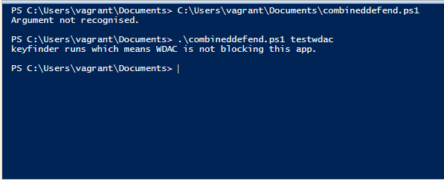
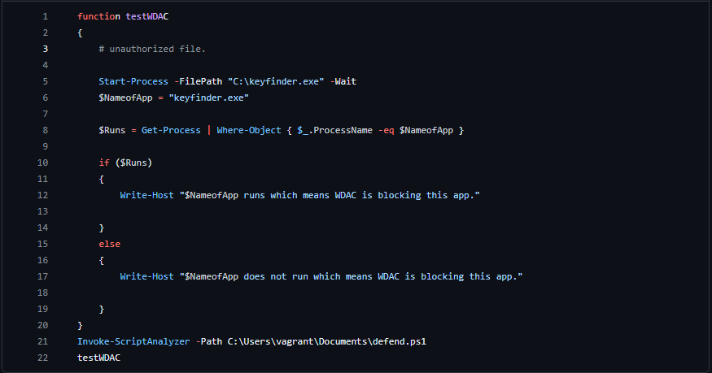
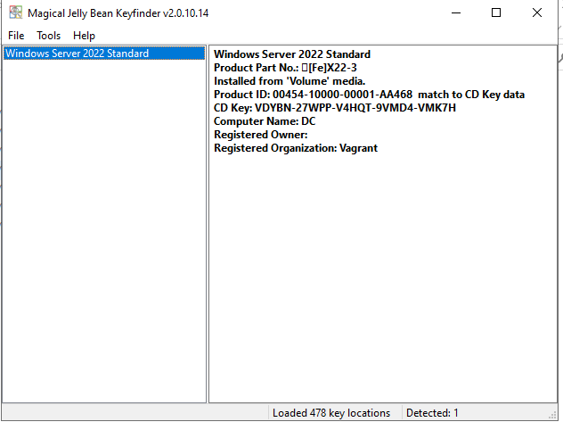
Function testWDAC () This function tests if the application runs or not. In this case the app was not blocked by WDAC The file that runs is defendfunctions.ps1 from GitHub

Slide 4
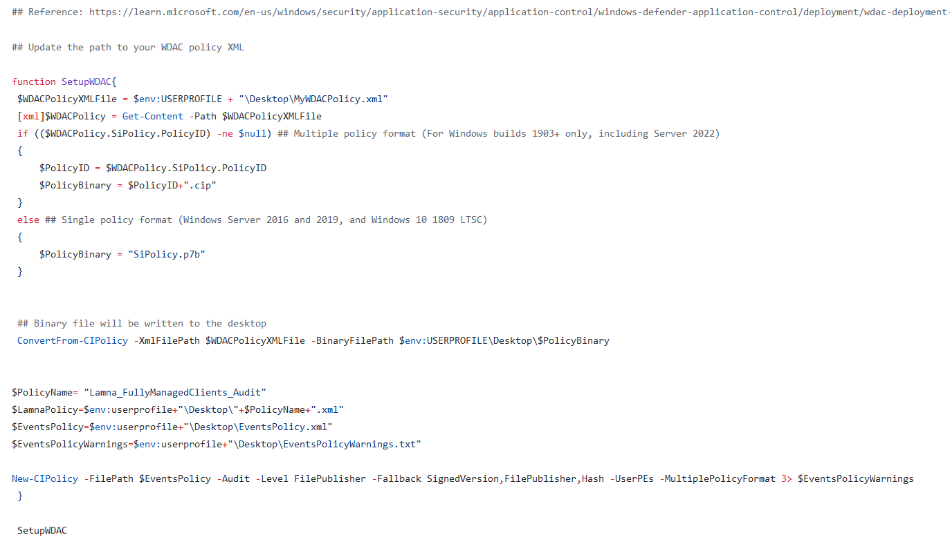
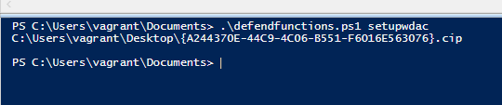
Function setupWDAC() This function helps to setup the WDAC policy. The policy xml file is converted to binary file.

Slide 5
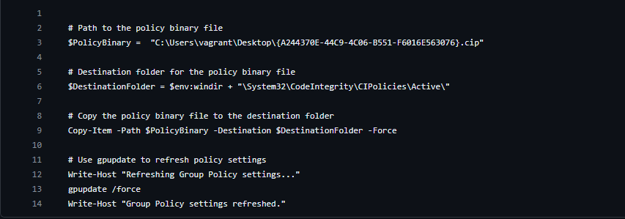
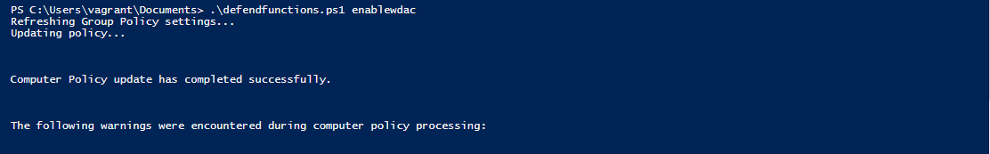
Function enableWDAC() This function helps to enable the WDAC policy file. This will help WDAC file to block any unauthorized application.

Slide 6
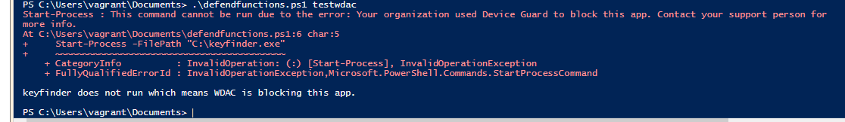
Rerunning testWDAC() After we enable the WDAC Policy we will rerun testWDAC() to see if the app is blocked from running.

Slide 7
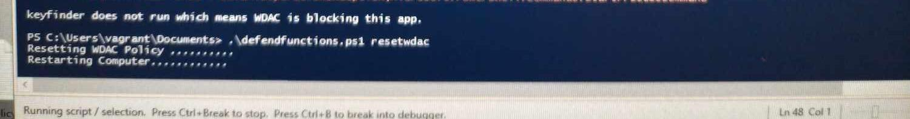
Function resetWDAC() At last we will be resetting the WDAC policy file to revert that to original position.

Slide 8

THE END Thank You.

